Slide 1





Big data
Scalable
Lyrics Analyzer

Slide 2
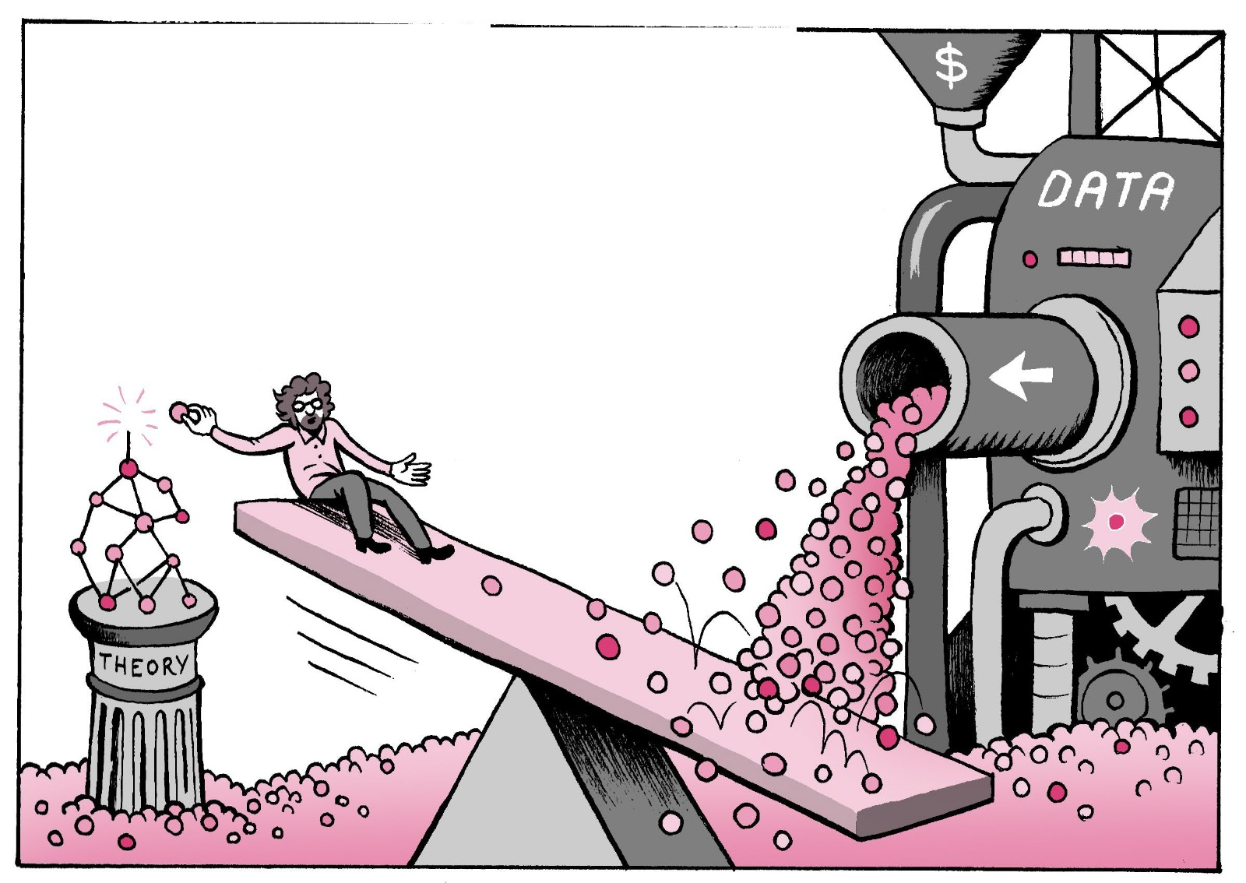
What is the problem ?

Slide 3
What is the Problem ?
Nowadays, most song recommendation systems rely heavily on tagged songs and genres, and they do not account for their contents. There are 150-300 words per song on average according to the research. Every song recommendation system may have millions of songs (for example Spotify has more than 50 million songs). Analyzing lyrics for such a big amount of songs may be a time-consuming task.
Our algorithm will analyze songs based on their lyrics, which may be able to serve song databases for user recommendation.
Notes:
http://lhttp://lab.musixmatch.com/vocabulary_genres/ab.musixmatch.com/vocabulary_genres/
https://newsroom.spotify.com/company-info/

Slide 4
The Analysis
The worker will process the song and create an histogram for a song and the artist’s song based on various features, such as:
Length (Word Count)
amount of positive/negative words
the “feeling” the song may convey (happy, sad, scary, angry...)(using NRC Emotion Lexicon)
Notes:
https://saifmohammad.com/WebPages/NRC-Emotion-Lexicon.htm

Slide 5
150 - 300 words/song
57,000+ songs
8,550,000 - 17,100,000
*Average for song
From Kaggle database
Words to analyze
*http://lab.musixmatch.com/vocabulary_genres/ (3rd December, 2015 )
Notes:
http://lab.musixmatch.com/vocabulary_genres/

Slide 6
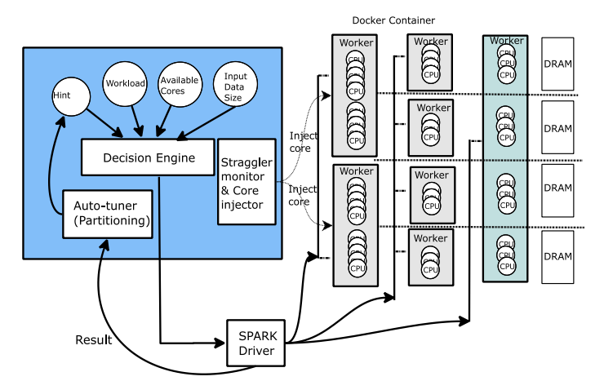
Suggested by research solution
https://www.researchgate.net/publication/316611536_Improving_scalability_of_apache_spark-based_scale-up_server_through_docker_container-based_partitioning
Notes:
https://www.researchgate.net/publication/316611536_Improving_scalability_of_apache_spark-based_scale-up_server_through_docker_container-based_partitioning

Slide 7
How can we analyze so much data in such a short time?
Suppose we have one worker that is able to analyze a batch of songs for us.
If we would be able to duplicate our worker so that they could analyze a huge collection of songs in a very short time, we may drastically improve performance and reduce time needed for data analyse .
In our project we implemented a scalable Producer-Consumer architecture.

Slide 8
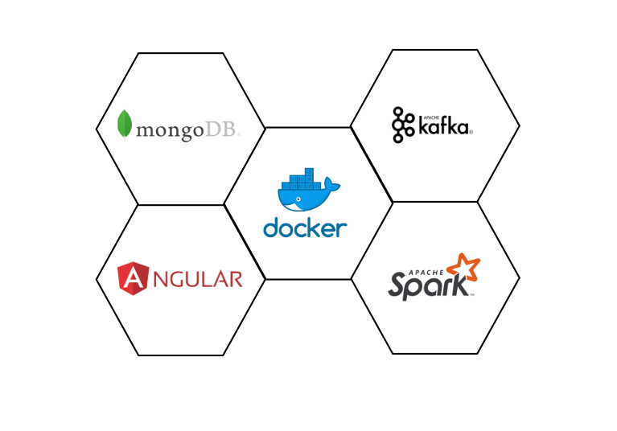
Technologies Used

Slide 9
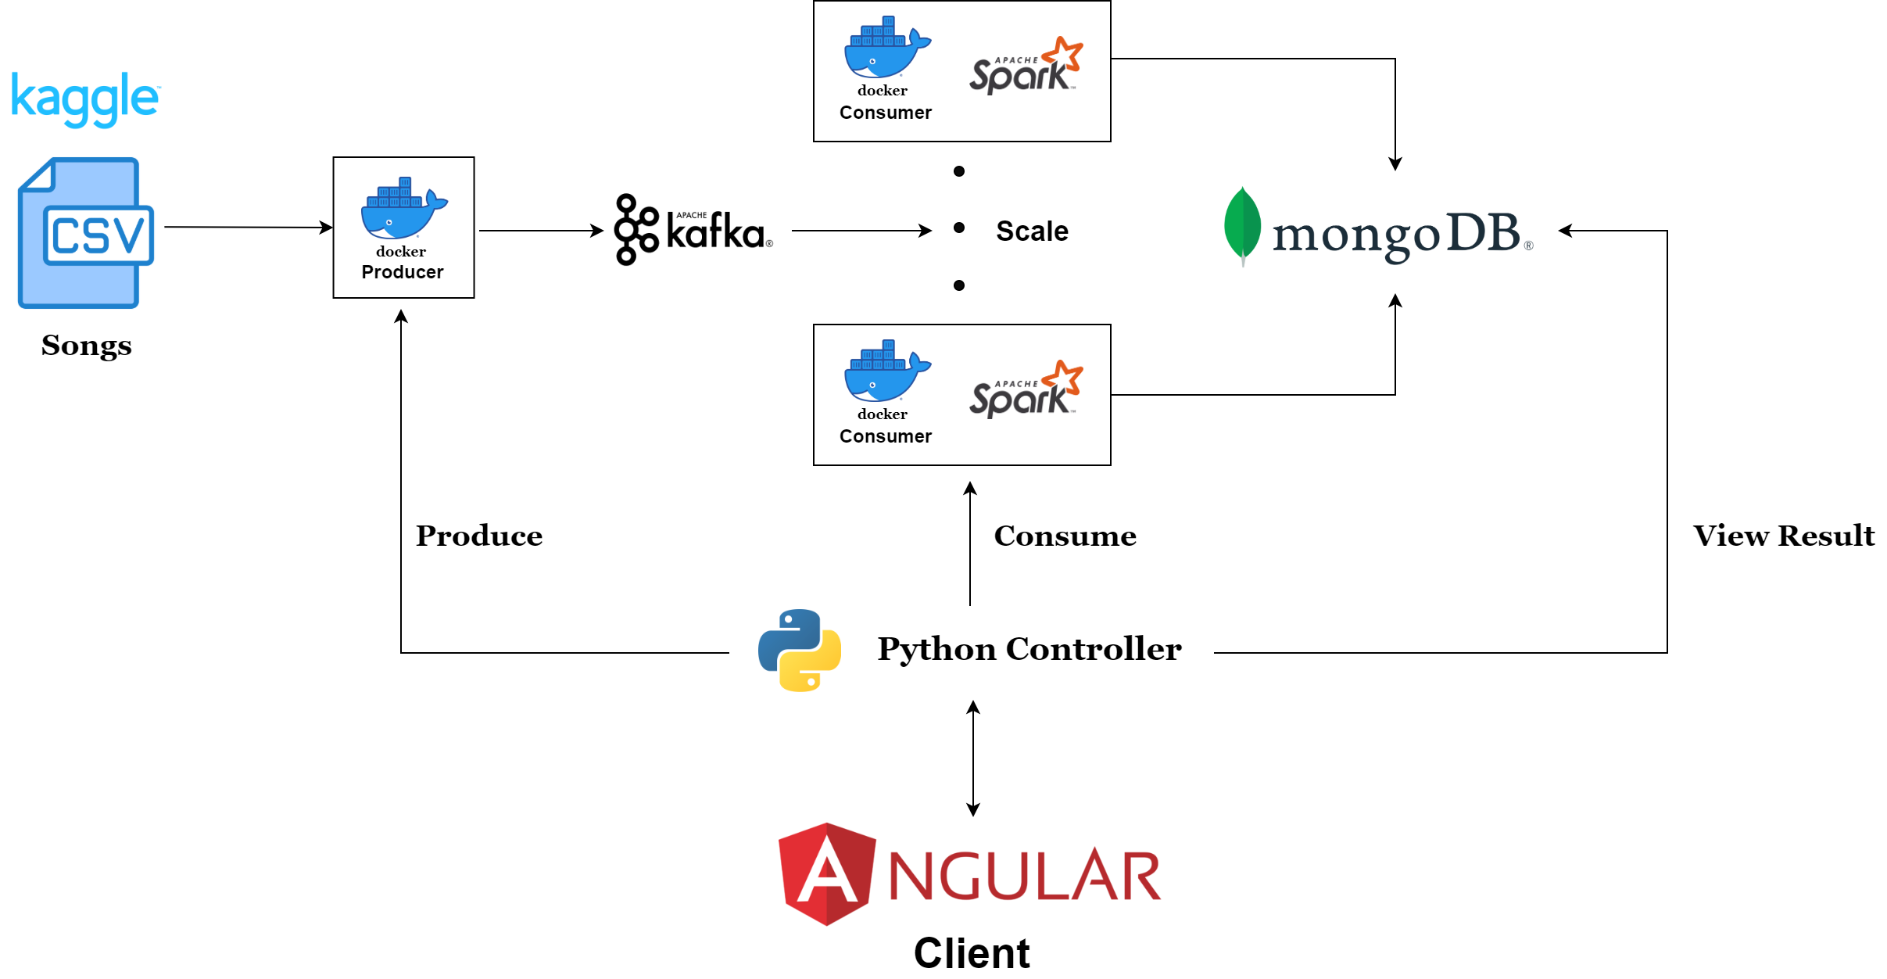
Project Architecture

Slide 10
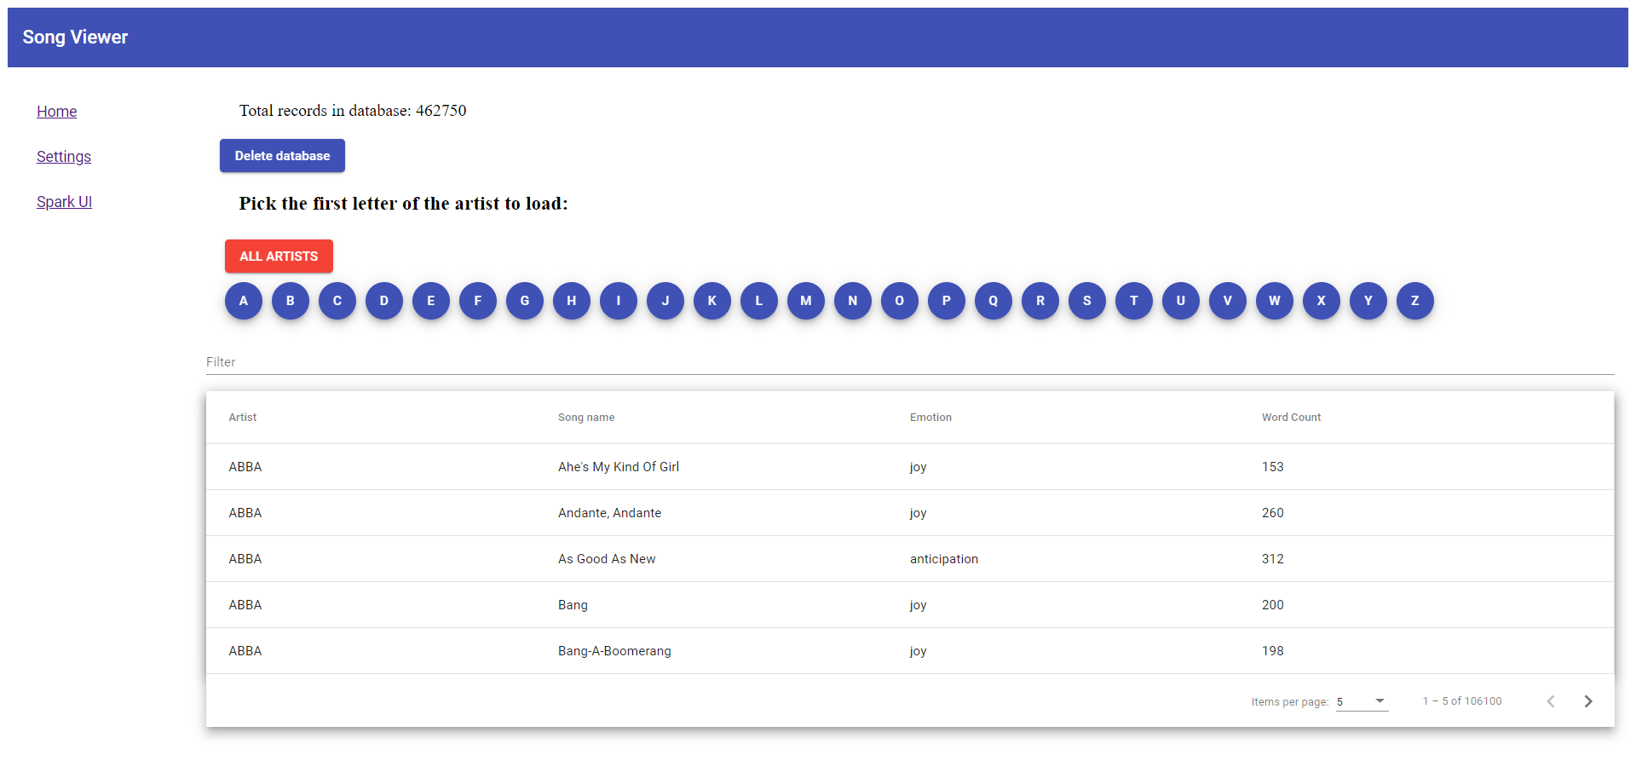
Client GUI Home Tab

Slide 11
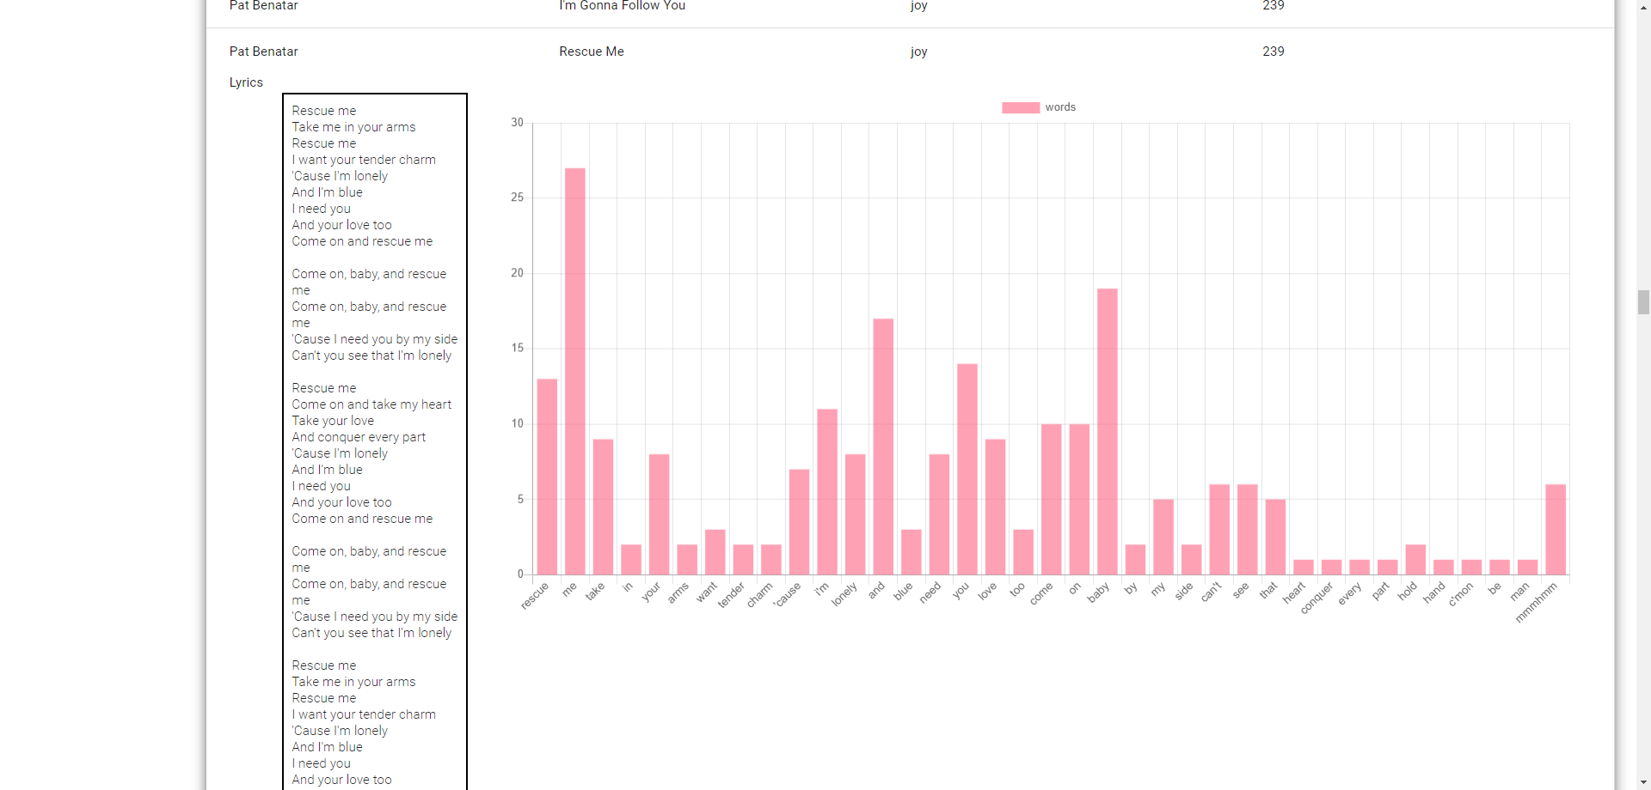
Client GUI output Statistics for individual song

Slide 12
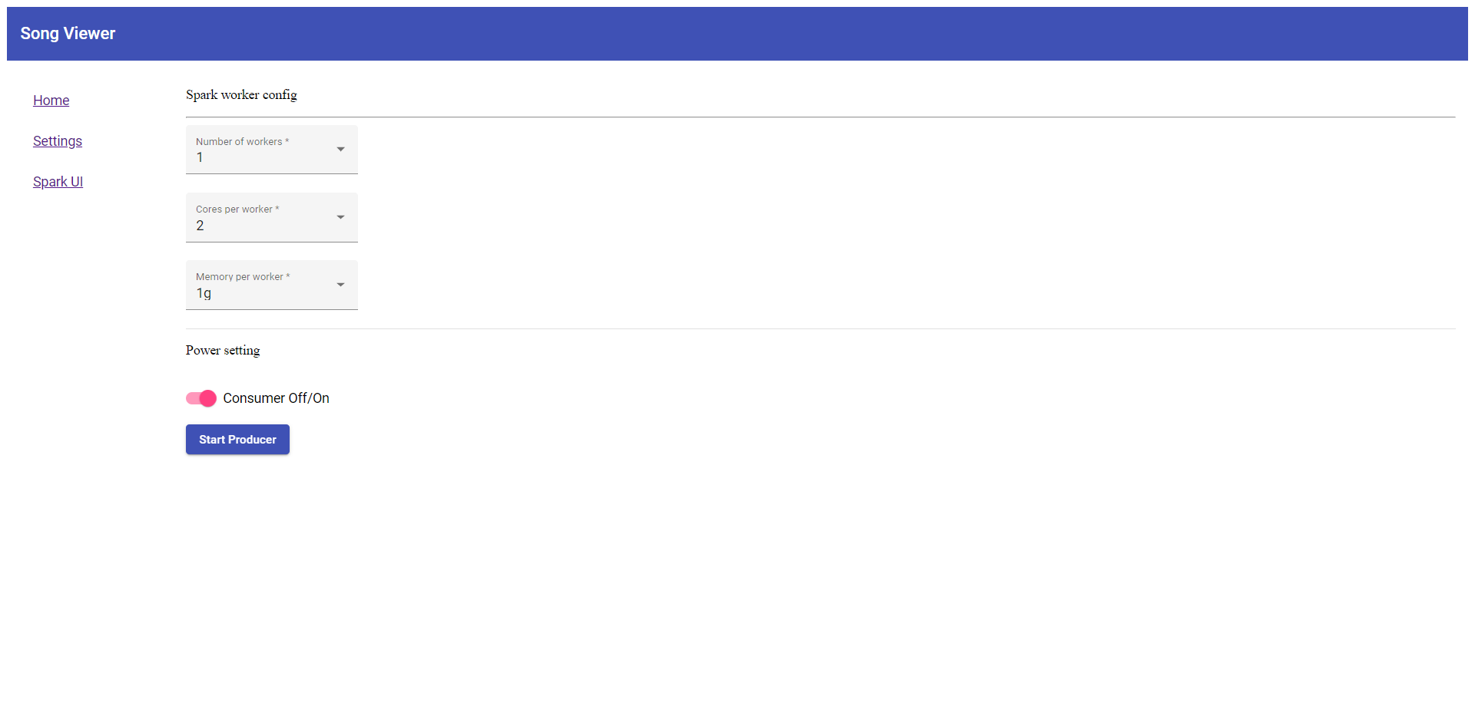
Client GUI Settings Tab

Slide 13
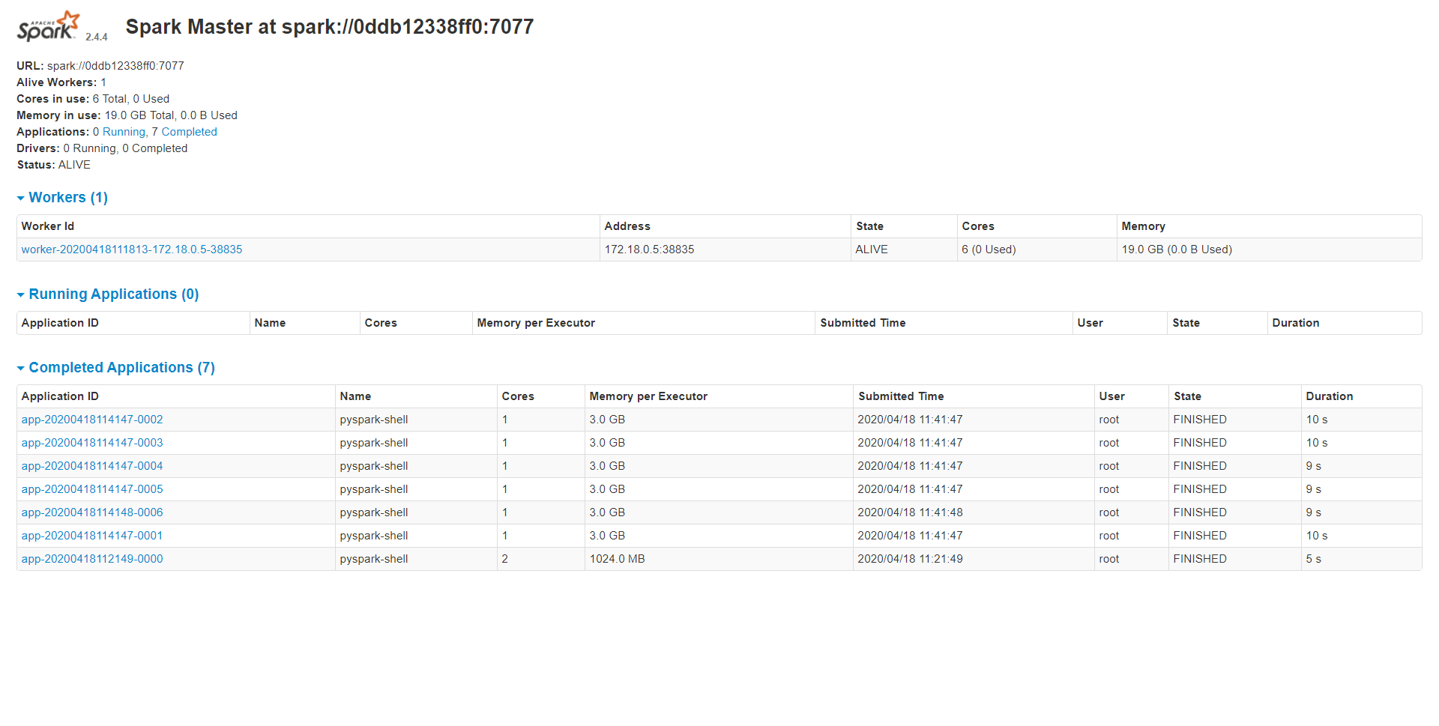
Client GUI Spark Tab

Slide 14
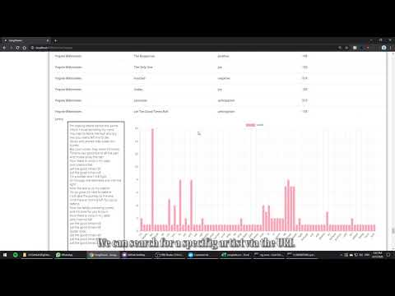
https://www.youtube.com/watch?v=8KSoSkRzCaY&feature=youtu.be

Slide 15

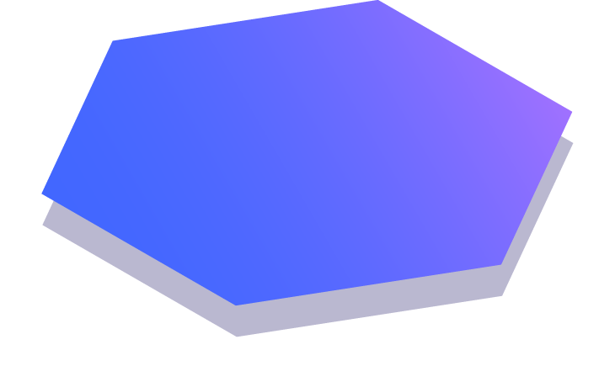
Thanks!
Liran Nachman 311342836
Eden Dupont 204808596
Daniel Rolnik 334018009
Eden Sharoni 315371906
Any questions?

